Slide 1
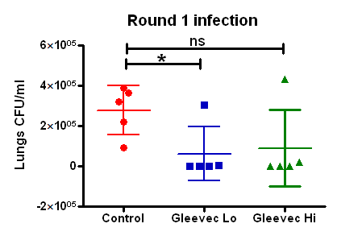
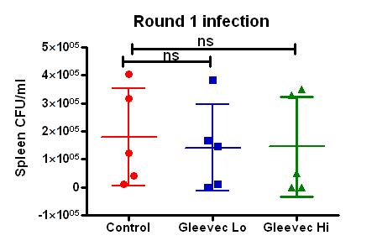
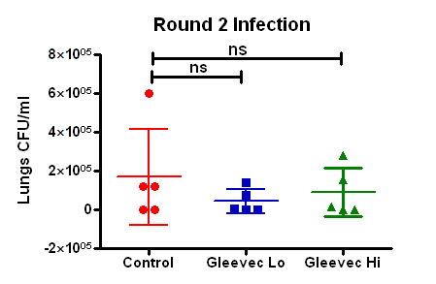
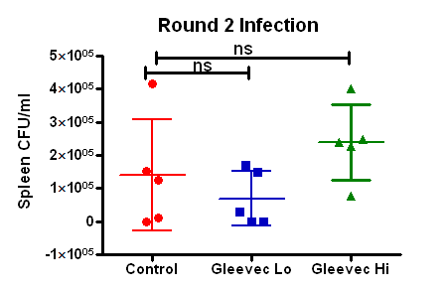

Slide 2
Date of Infection : 12/16/10
Date of Timepoint: 1/13/11-1/14/11
Sham Treated Lungs
 | Implant status | CFU
M1 | Intact | 2.22E+05
M2 | Intact | 3.88E+05
M3 | Intact | 9.40E+04
M4 | Intact | 3.66E+05
M5 | Intact | 3.22E+05
M6 | Intact | 0
M7 | Intact | 1.22E+05
M8 | Intact | 1.22E+05
M9 | Intact | 0
M10 | Intact | 6.00E+05
Gleevec Lo Lungs
 | Implant status | CFU
M1 | Intact | 3.04E+05
M2 | Intact | 0
M3 | Intact | 0
M4 | Intact | 6.00E+03
M5 | Intact | 0
M6 | Intact | 6.00E+03
M7 | 12/23/10 | 1.42E+05
M8 | Intact | 0
M9 | Intact | 0
M10 | 12/25/10 | 7.40E+04
Gleevec Hi Lungs
 | Implant status | CFU
M1 | 1/8/11 | 0
M2 | Intact | 4.32E+05
M3 | Intact | 2.00E+04
M4 | Intact | 0
M5 | Intact | 0
M6 | 1/8/11 | 1.54E+05
M7 | 1/8/11 | 2.80E+05
M8 | Intact | 1.60E+04
M9 | Intact | 0
M10 | Intact | 0

Slide 3
Date of Infection : 12/16/10
Date of Timepoint: 1/13/11-1/14/11
Sham Treated Spleen
 | Implant status | CFU
M1 | Intact | 1.00E+04
M2 | Intact | 3.18E+05
M3 | Intact | 4.20E+04
M4 | Intact | 4.04E+05
M5 | Intact | 1.22E+05
M6 | Intact | 0
M7 | Intact | 1.52E+05
M8 | Intact | 1.24E+05
M9 | Intact | 1.00E+04
M10 | Intact | 4.16E+05
Gleevec Lo Spleen
 | Implant status | CFU
M1 | Intact | 1.68E+05
M2 | Intact | 1.20E+04
M3 | Intact | 0
M4 | Intact | 3.82E+05
M5 | Intact | 1.46E+05
M6 | Intact | 1.70E+05
M7 | 12/23/10 | 2.80E+04
M8 | Intact | 0
M9 | Intact | 0
M10 | 12/25/10 | 1.48E+05
Gleevec Hi Spleen
 | Implant status | CFU
M1 | 1/8/11 | 5.00E+04
M2 | Intact | 3.50E+05
M3 | Intact | 3.30E+05
M4 | Intact | 0
M5 | Intact | 0
M6 | 1/8/11 | 2.48E+05
M7 | 1/8/11 | 2.38E+05
M8 | Intact | 4.00E+05
M9 | Intact | 7.80E+04
M10 | Intact | 2.28E+05

Slide 4
Lung and Spleen comparison
Sham Treated Lungs
 | Implant status | CFU
M1 | Intact | 2.22E+05
M2 | Intact | 3.88E+05
M3 | Intact | 9.40E+04
M4 | Intact | 3.66E+05
M5 | Intact | 3.22E+05
M6 | Intact | 0
M7 | Intact | 1.22E+05
M8 | Intact | 1.22E+05
M9 | Intact | 0
M10 | Intact | 6.00E+05
Sham Treated Spleen
 | Implant status | CFU
M1 | Intact | 1.00E+04
M2 | Intact | 3.18E+05
M3 | Intact | 4.20E+04
M4 | Intact | 4.04E+05
M5 | Intact | 1.22E+05
M6 | Intact | 0
M7 | Intact | 1.52E+05
M8 | Intact | 1.24E+05
M9 | Intact | 1.00E+04
M10 | Intact | 4.16E+05

Slide 5
Lung and Spleen comparison
Gleevec Lo Lungs
 | Implant status | CFU
M1 | Intact | 3.04E+05
M2 | Intact | 0
M3 | Intact | 0
M4 | Intact | 6.00E+03
M5 | Intact | 0
M6 | Intact | 6.00E+03
M7 | 12/23/10 | 1.42E+05
M8 | Intact | 0
M9 | Intact | 0
M10 | 12/25/10 | 7.40E+04
Gleevec Lo Spleen
 | Implant status | CFU
M1 | Intact | 1.68E+05
M2 | Intact | 1.20E+04
M3 | Intact | 0
M4 | Intact | 3.82E+05
M5 | Intact | 1.46E+05
M6 | Intact | 1.70E+05
M7 | 12/23/10 | 2.80E+04
M8 | Intact | 0
M9 | Intact | 0
M10 | 12/25/10 | 1.48E+05

Slide 6
Lung and Spleen comparison
Gleevec Hi Lungs
 | Implant status | CFU
M1 | 1/8/11 | 0
M2 | Intact | 4.32E+05
M3 | Intact | 2.00E+04
M4 | Intact | 0
M5 | Intact | 0
M6 | 1/8/11 | 1.54E+05
M7 | 1/8/11 | 2.80E+05
M8 | Intact | 1.60E+04
M9 | Intact | 0
M10 | Intact | 0
Gleevec Hi Spleen
 | Implant status | CFU
M1 | 1/8/11 | 5.00E+04
M2 | Intact | 3.50E+05
M3 | Intact | 3.30E+05
M4 | Intact | 0
M5 | Intact | 0
M6 | 1/8/11 | 2.48E+05
M7 | 1/8/11 | 2.38E+05
M8 | Intact | 4.00E+05
M9 | Intact | 7.80E+04
M10 | Intact | 2.28E+05

